Slide 1

Smart Local Bank Office
Gregory Gregoriades

Slide 2

Value Proposition
Statistics/Analytics for power consumption
Automate life at work
Help save power
Monitor messenger car
Make working environment friendlier

Slide 3

Customer Segments
Banks
Bank managers
Bank employees

Slide 4

Channels
Web page
Social media
Newspapers
Popular banks

Slide 5

Customer Relationships
Co-creation of value
User feedback
New ideas
Long-term relationship
Customer support
Updates
Maintenance

Slide 6

Revenue Streams
Fee for installation
70 Euros
Scalable monthly subscription fee
35 Euros Simple Package
Scalable Based on Updates/Upgrades
A fee for upgrades
Depends on the extra sensors’ prices

Slide 7

Key Resources
Physical Resources
Servers
Databases
Sensors
Actuators
Human Resources
Development Team
Maintenance and Installation Team
Intellectual Resources
Customer feedback and ideas

Slide 8

Key Activities
Installation
Collect and Analyze data to Provide Statistics/Analytics
Develop intelligent AI and algorithms
Create Server/Platform
Maintenance
Updates/Upgrades

Slide 9

Key Partners
Hardware providers
Bank Managers
Bank Employees

Slide 10

Cost Structure
Our Crew
Development Team
Maintenance and Installation team
Salary measured in man-hours
Hardware
Sensors
From 4 Euros to 45 Euros
Actuators
LED lights 66 Euros
Servers
Pay what you use

Slide 11
Requirements
Functional
Sensors
Actuators
Non-Functional
Algorithms

Slide 12
Functional Requirements
GPS Tracker
Temperature and Humidity Sensors
Light Detector Module
Camera Module
Dimming modern LED ceiling lights

Slide 13
Non-Functional Requirements
LED lights Algorithm
Air Conditioning algorithm

Slide 14
General Requirements
Reliability
Lights and AC wont turn on/off unless the system is certain
Availability
The system must be running 24/7
Plug n’ Play
Security
Maintainability
Component based system, which means easy Maintenance
Portability
System should be usable wirelessly

Slide 15
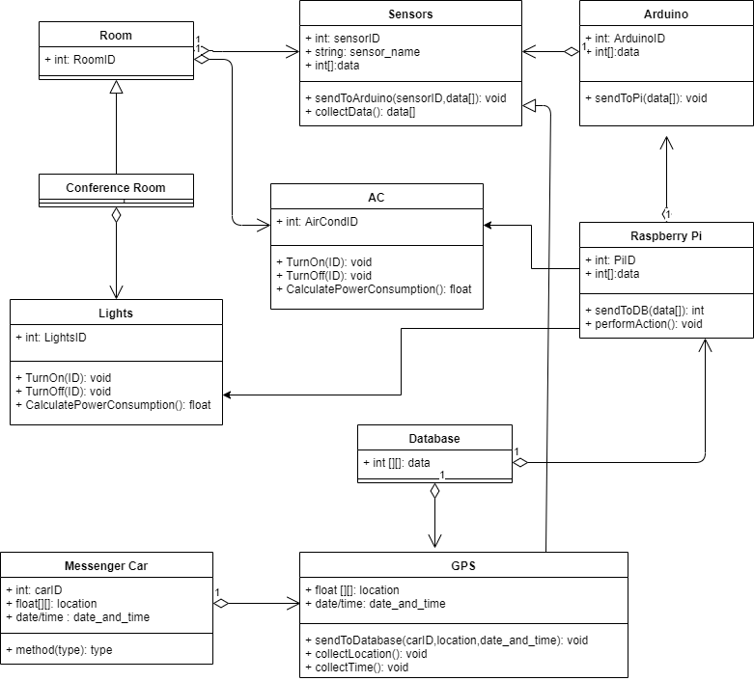
UML Diagram

Slide 16
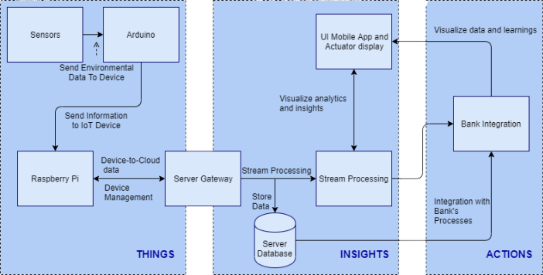
Architecture & Design

Slide 17

Any Questions?

Slide 18
Thank you!!

